Slide 1
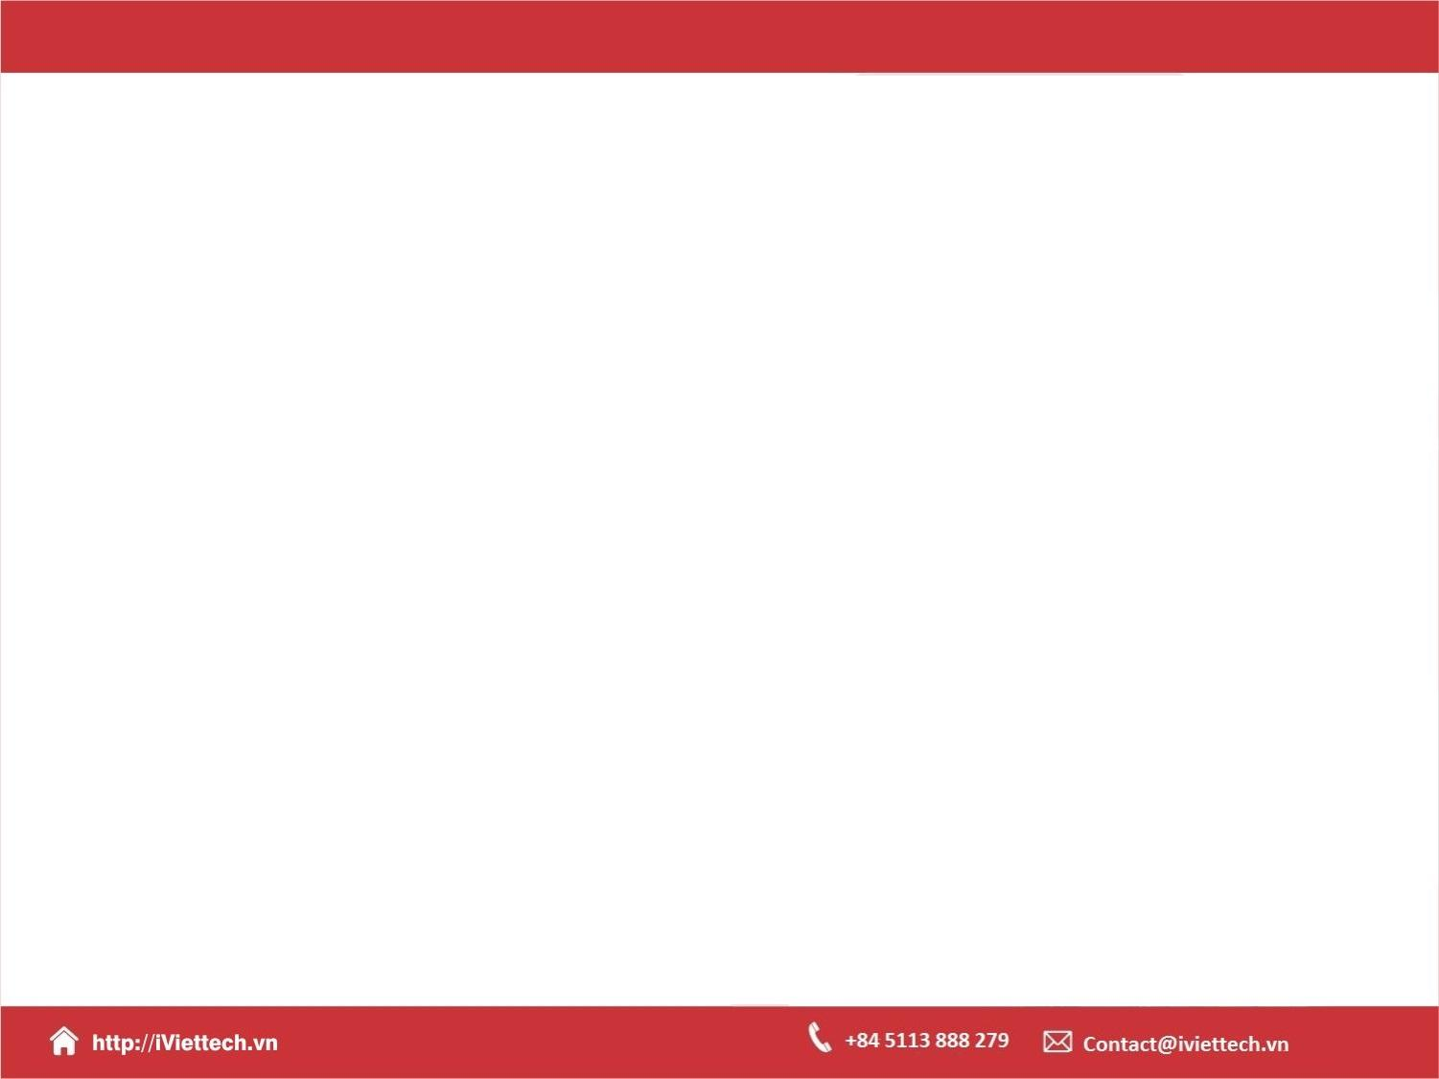
Chapter 12
Building a REST API

Slide 2

Objectives
This chapter introduces REST APIs and Django REST Framework (DRF).
You will learn about the serialization of model instances.
You will explore different types of API views, including both functional and class-based types.
You will be able to implement custom API endpoints, including simple authentication

Slide 3
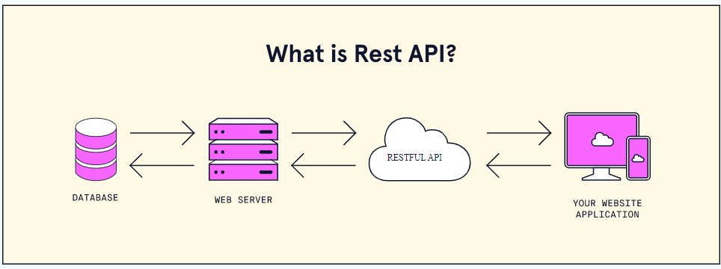
REST APIs

Slide 4
What is a REST API?
A REST API is a popular way for systems to expose useful functions and data. REST, which stands for representational state transfer, can be made up of one or more resources that can be accessed at a given URL and returned in various formats, like JSON, images, HTML, and more.

Slide 5
Why Django REST framework?
Django REST framework (DRF) is a powerful and flexible toolkit for building Web APIs. Its main benefit is that it makes serialization much easier.
Django REST framework is based on Django’s class-based views, so it’s an excellent option if you’re familiar with Django.

Slide 6
Setting up Django REST framework
pip install django
pip install django_rest_framework
Create a Django project called todo with the following command
django-admin startproject todo

Slide 7
Setting up Django REST framework
Then, cd into the new todo folder and create a new app for your API:
django-admin startapp todo_api
Run your initial migrations of the built-in user model:
python manage.py migrate

Slide 8
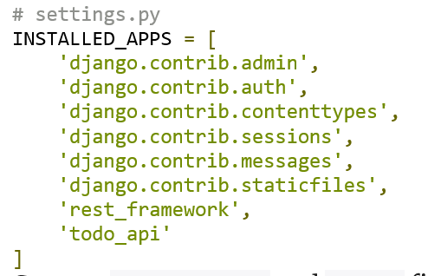
Setting up Django REST framework
Next, add rest_framework and todo to the INSTALLED_APPS inside the todo/todo/settings.py file:

Slide 9
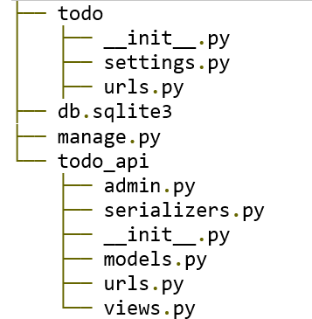
Setting up Django REST framework
Create a serializers.py and urls.py file in todo/todo_api and add new files as configured in the directory structure below

Slide 10
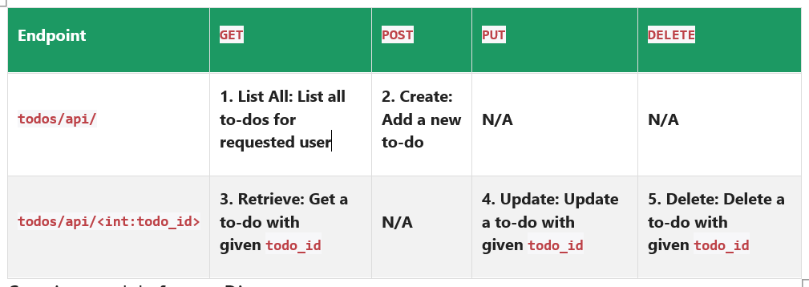
Setting up Django REST framework

Slide 11
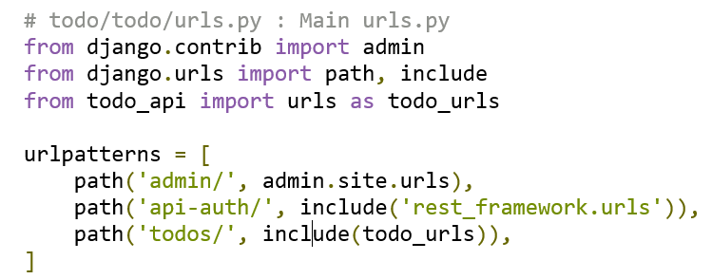
Setting up Django REST framework
Be sure to include rest_framework and URLs as shown below in your main urls.py file:

Slide 12
Setting up Django REST framework
Next, create a superuser. We’ll come back to this later:
python manage.py createsuperuser
RESTful structure: GET, POST, PUT, and DELETE methods
In a RESTful API, endpoints define the structure and usage with the GET, POST, PUT, and DELETE HTTP methods. You must organize these methods logically.

Slide 13
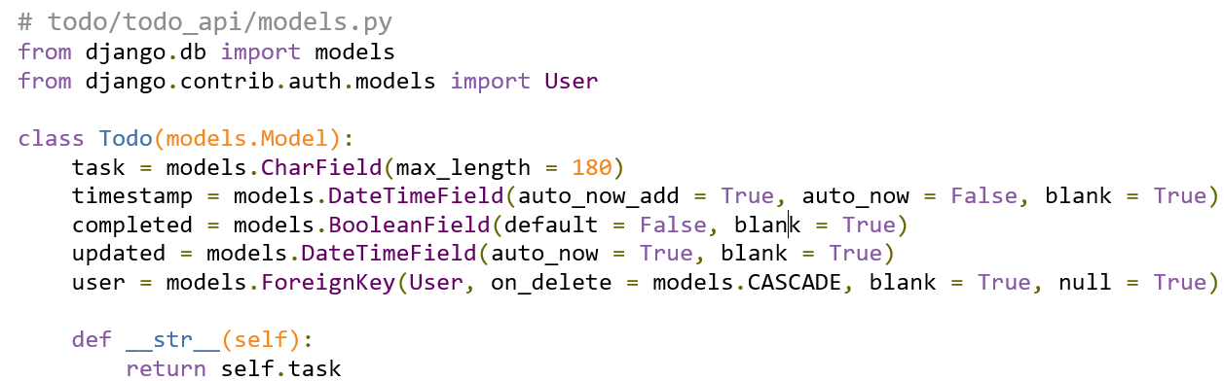
Creating models for our Django app
Let’s start by creating the model for our to-do list:

Slide 14
Setting up Django REST framework
After creating the model, migrate it to the database
python manage.py makemigrations
python manage.py migrate

Slide 15
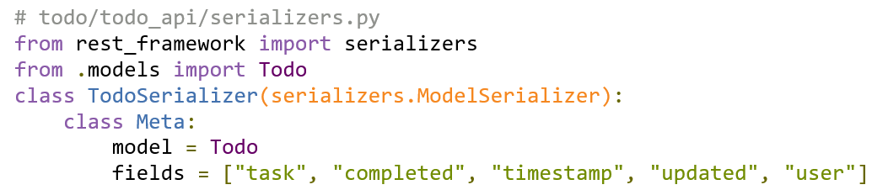
Model serializer
To convert the Model object to an API-appropriate format like JSON, Django REST framework uses the ModelSerializer class to convert any model to serialized JSON objects:

Slide 16
Creating API views in Django

Slide 17
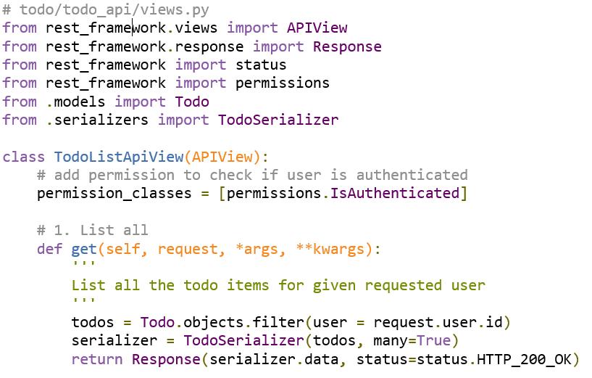
List view

Slide 18
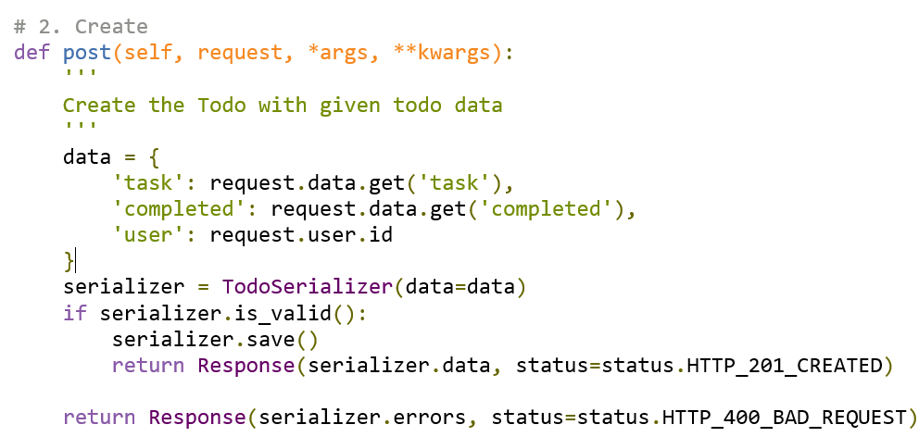
List view

Slide 19
List view
Run the Django server:
python manage.py runserver
Now, we’re ready for the first test. Navigate to http://127.0.0.1:8000/todos/api/. Make sure you’re logged in with your superuser credentials:

Slide 20
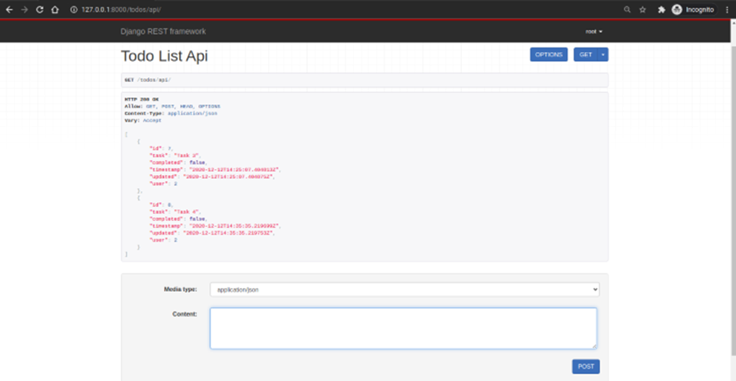
List view

Slide 21
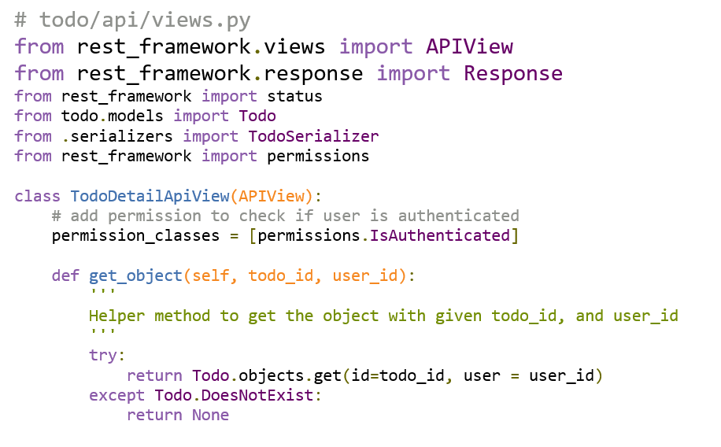
Detail view
Now that we’ve successfully created our first endpoint view, let’s create the second endpoint todos/api/<int:todo_id> API view.

Slide 22
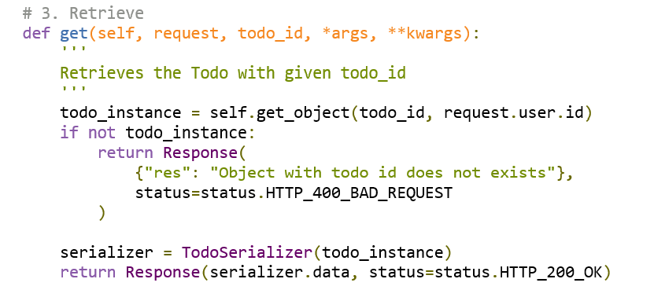
Detail view

Slide 23
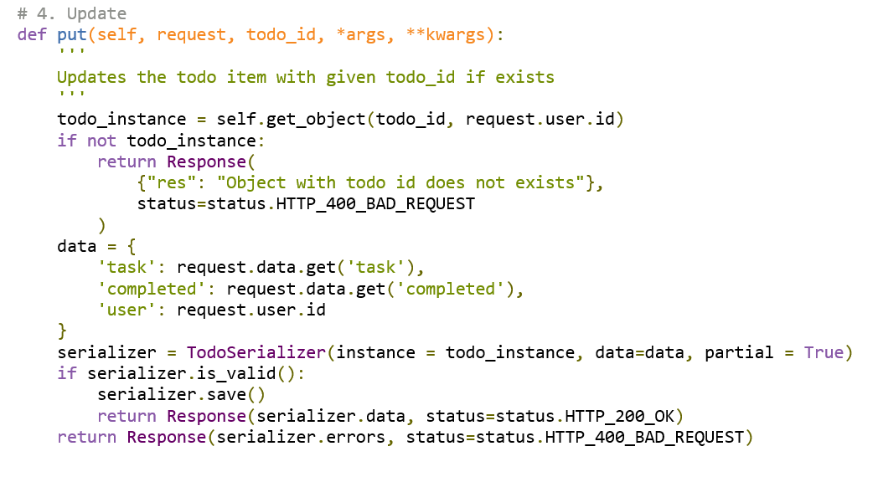
Detail view

Slide 24
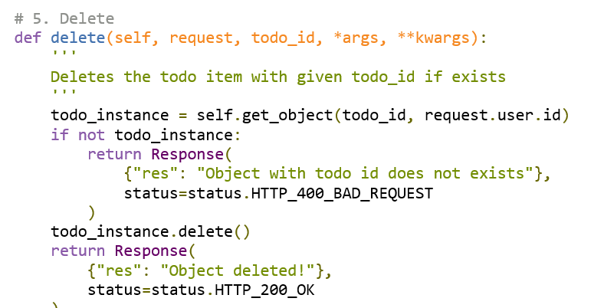
Detail view

Slide 25
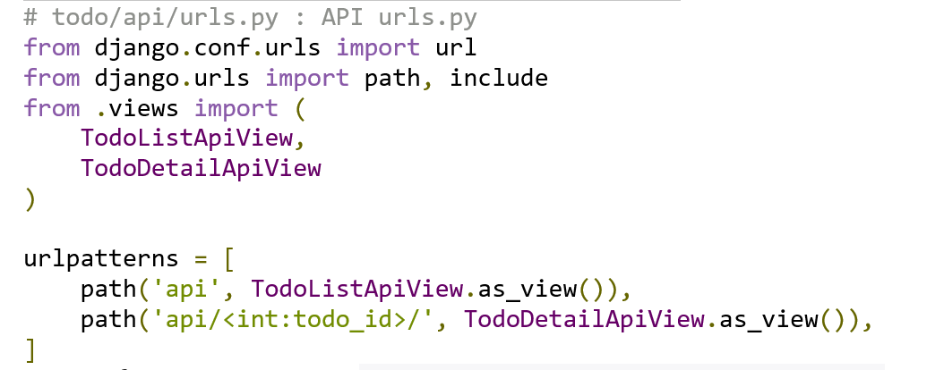
Detail view
Update the API urls.py as demonstrated below

Slide 26
Detail view
Now, if you navigate to http://127.0.0.1:8000/todos/api/<id>/, it will show the detail API view page. Notice that you correctly navigate to a valid ID. In the screenshot below, I used 7 as the ID

Slide 27
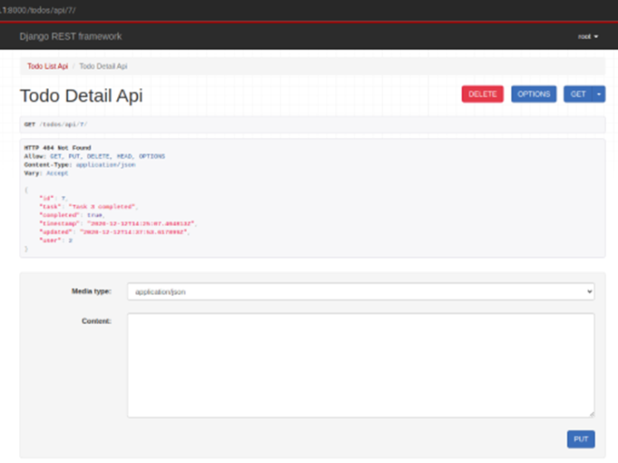
Detail view

Slide 28
Summary
This chapter introduced REST APIs, a fundamental building block in most real-world web applications.
These APIs facilitate communication between the backend server and the web browser, so they are central to your growth as a Django web developer.
Notes:
https://blog.logrocket.com/django-rest-framework-create-api/

